Slide 1

Vel Tech Rangarajan Dr. Sagunthala R&D Institute of Science and Technology
School of Computing
Department of Computer Science and Engineering
10211CS224 / FULL STACK APPLICATION DEVELOPMENT (JAVA)
PROJECT REVIEW : MILESTONE PROJECT – 1
Date: 09-03-2026
Full-Stack Skill Learning Academy Marketplace with Secure Authentication
SDG: SDG 4 – Quality Education
Presented By:
GADDAM NITHESH REDDY– VTU25659 – 23UECS0718.
Courses Handling Faculty:
Dr. S . HEMAMALINI – M.E., Ph.D.,

Slide 2
INTRODUCTION
With the rapid growth of online education, there is a need for platforms where learners can easily discover and enroll in skill-based courses.
This project aims to solve that problem by creating a Full-Stack Skill Learning Academy Marketplace.
The platform allows instructors to publish courses and students to browse, search, and enroll in them.
Secure authentication and role-based access control ensure safe access for Admin, Instructor, and Student users.
The system helps instructors manage their courses while students can track their enrollments and learning progress.
Admin users can monitor platform activity, manage users, and view analytics.
Overall, the system demonstrates a real-world full-stack web application using HTML, CSS, JavaScript, Node.js, and MySQL.
1
2
3
4
5
6
7
8
9

Slide 3
PROBLEM STATEMENT
- Many online learning platforms do not provide a simple marketplace where instructors can easily publish courses and students can discover them in one place.
- Existing systems often lack proper role-based access control for Admin, Instructor, and Student users.
- Managing courses, enrollments, and user data manually or through separate systems leads to inefficiency.
- Students also face difficulty in searching and enrolling in skill-based courses from different sources.
- There is a need for a centralized platform that connects instructors and learners efficiently.
-The system should provide secure authentication and proper user management.
- It should also allow instructors to manage courses and students to track their learning progress.
- Therefore, a Full-Stack Skill Learning Academy Marketplace is required to provide an organized and automated learning platform.
1
2
3
4
5
6
7
8
9

Slide 4
OBJECTIVE(S)
1
- To design and develop a Full-Stack Skill Learning Academy Marketplace with secure authentication and role-based access for Admin, Instructor, and Student users.
- To implement a course management and enrollment system that allows instructors to create courses and students to browse, enroll, and track learning progress.
2
3
4
5
6
7
8
9

Slide 5
PROPOSED SYSTEM
- The system provides a web-based marketplace where students can browse and enroll in skill-based courses.
- It supports secure user authentication with role-based access for Admin, Instructor, and Student.
- Instructors can create, update, and manage courses through their dashboard.
- Students can search courses, view details, enroll, and track their progress.
- Admin can monitor users, courses, and platform statistics through an admin dashboard.
- The backend uses Node.js (Express) to handle API requests and business logic.
- The system uses MySQL database via XAMPP to store users, courses, enrollments, and payment data.
- The frontend built with HTML, CSS, and JavaScript provides a responsive interface for all users.
1
2
3
4
5
6
7
8
9

Slide 6
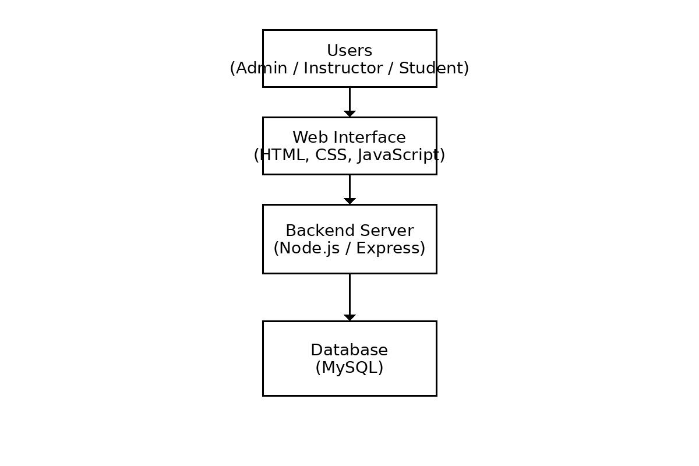
PROPOSED SYSTEM ARCHITECTURE
1
2
3
4
5
6
7
8
9

Slide 7
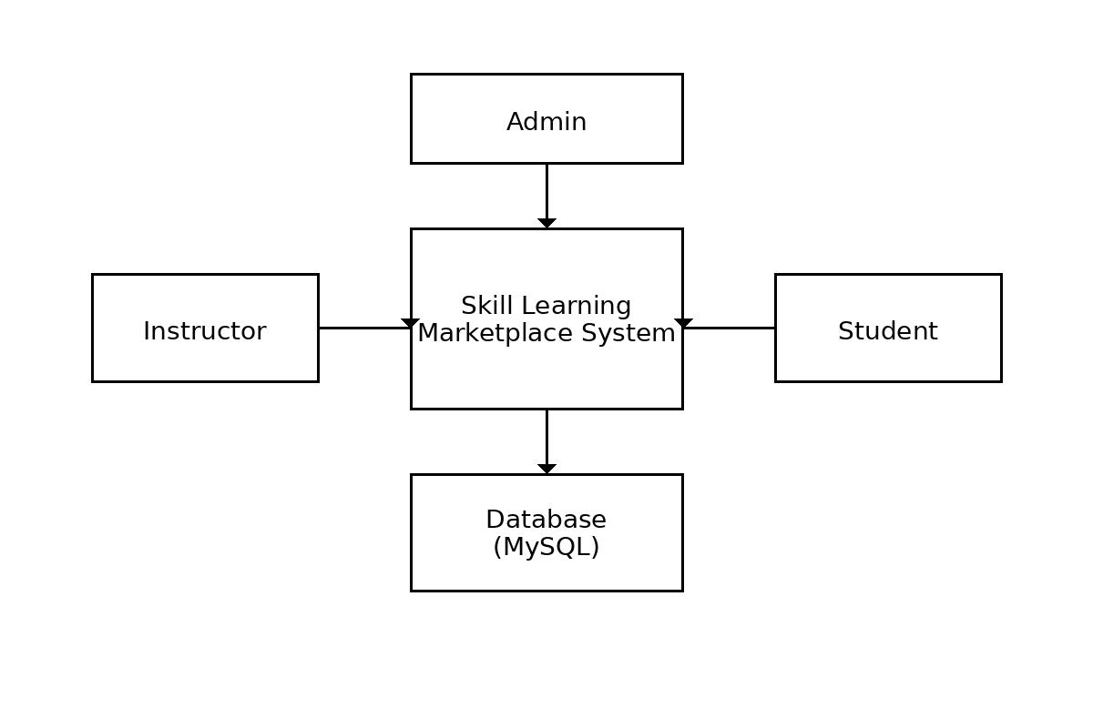
WORKFLOW
1
2
3
4
5
6
7
8
9

Slide 8
TECHNOLOGIES USED
Frontend: HTML5, CSS3, JavaScript (ES6)
Backend: Node.js with Express.js
Database: MySQL (using XAMPP)
Tools: Visual Studio Code, XAMPP, Git/GitHub, Postman, Web Browser (Chrome)
Hardware/Software Requirements: Processor: Intel i3 or higher RAM: Minimum 4 GB Operating System: Windows/Linux/MacOS Software: Node.js, XAMPP, Web Browser (Chrome/Edge)
1
2
3
4
5
6
7
8
9

Slide 9
MODULE DESCRIPTION
1
Module 1: User Authentication & Management Handles user registration, login, logout, and profile management with secure authentication and role-based access (Admin, Instructor, Student).
Module 2: Course Management Allows instructors to create, update, delete, and manage courses, including course details and categories.
Module 3: Enrollment Management Enables students to browse courses, enroll in selected courses, and track their learning progress.
Module 4: Admin Management & Analytics Allows the admin to manage users, monitor courses and enrollments, and view platform statistics and activity reports.
2
3
4
5
6
7
8
9

Slide 10
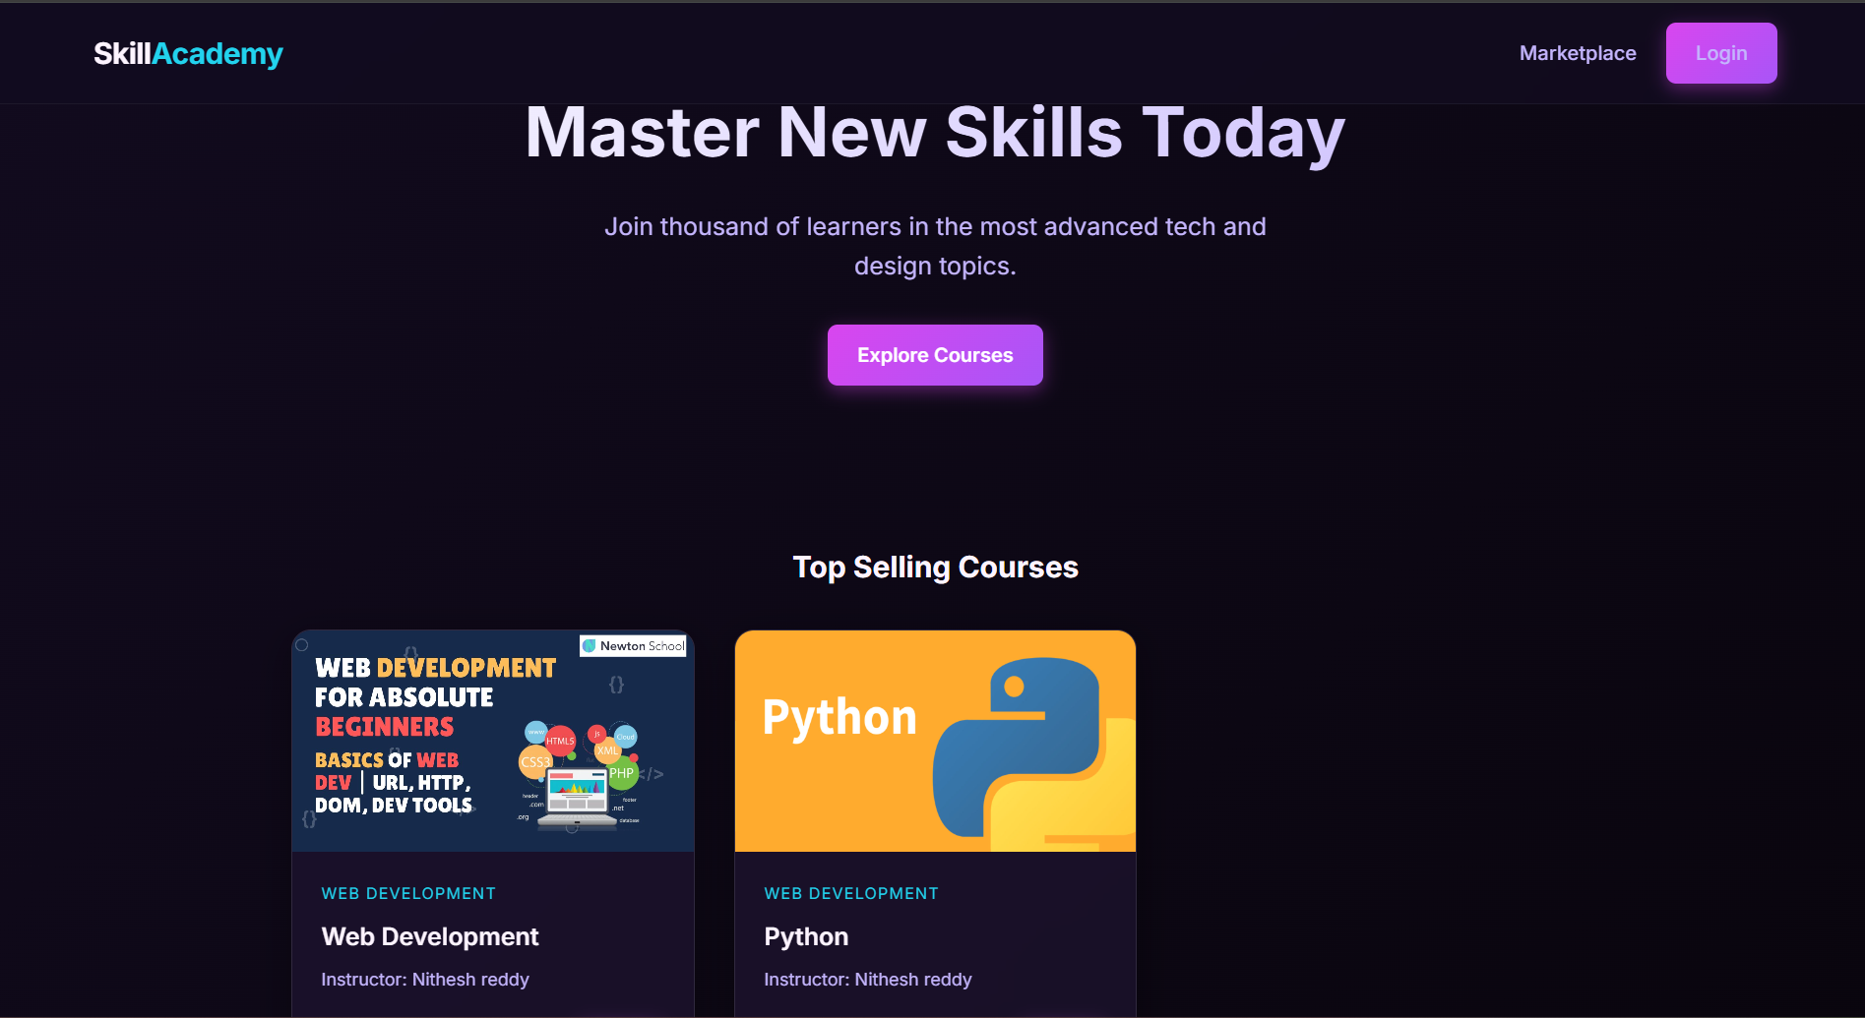
IMPLEMENTATION SCREENSHOTS
1
2
3
4
5
6
7
8
9

Slide 11
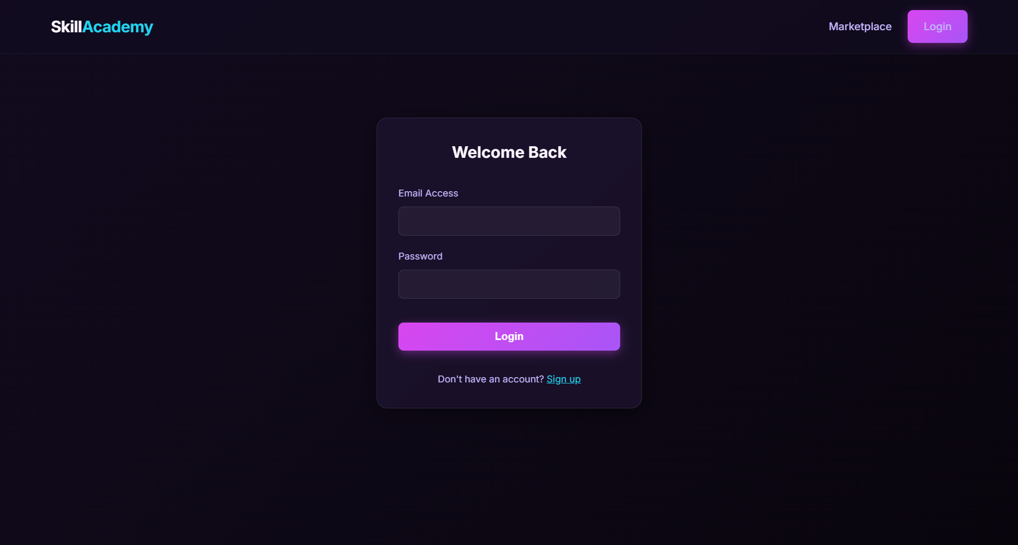
IMPLEMENTATION SCREENSHOTS
1
2
3
4
5
6
7
8(A)
9

Slide 12
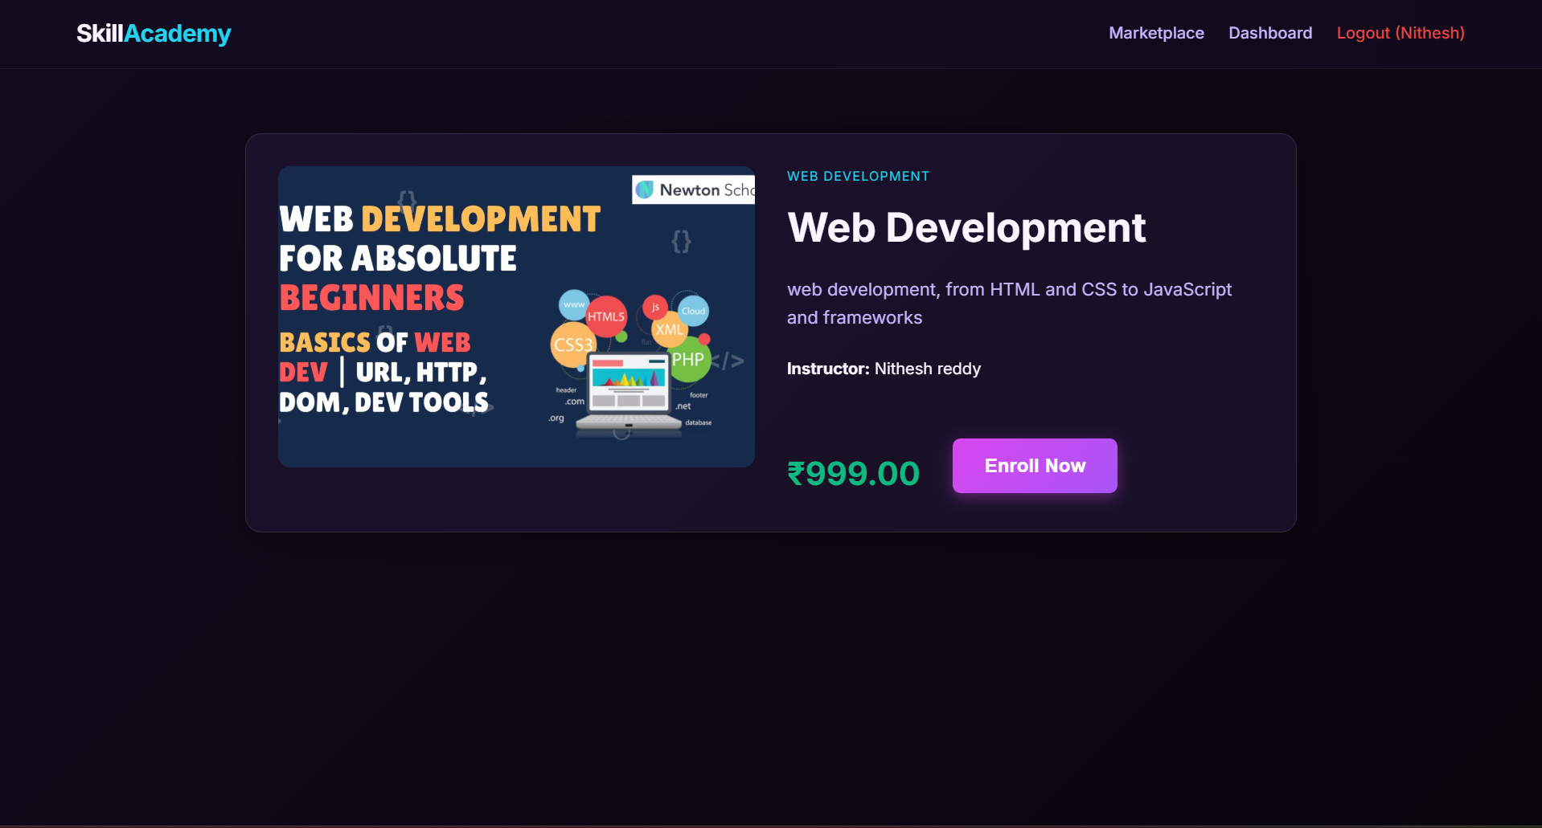
IMPLEMENTATION SCREENSHOTS
1
2
3
4
5
6
7
8(B)
9

Slide 13
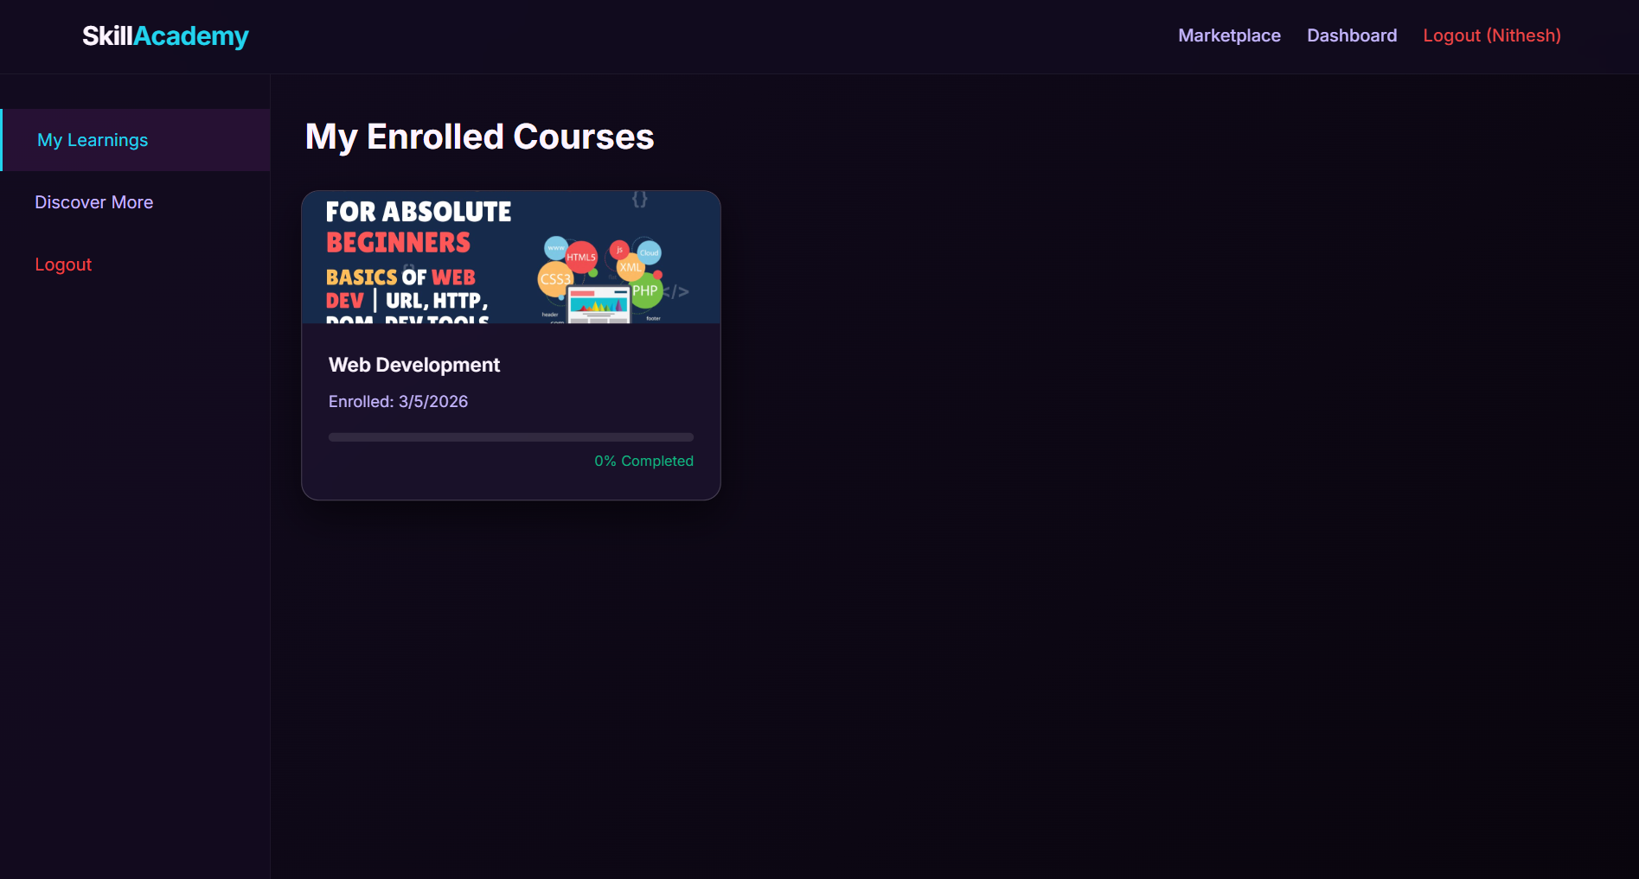
IMPLEMENTATION SCREENSHOTS
1
2
3
4
5
6
7
8(C)
9

Slide 14
ADVANTAGES & LIMITATIONS
1
Advantages
- Provides a centralized online learning platform.
- Supports secure login with role-based access.
- Easy course creation and enrollment.
- Efficient data management using MySQL.
- Improves accessibility to skill-based courses.
Limitations
- Requires internet connection.
- Setup may be difficult for beginners.
- Limited advanced features in basic version.
- Security risks if not properly maintained.
- Performance may reduce with many users.
2
3
4
5
6
7
8
9

Slide 15
Thank you

